Slide 1
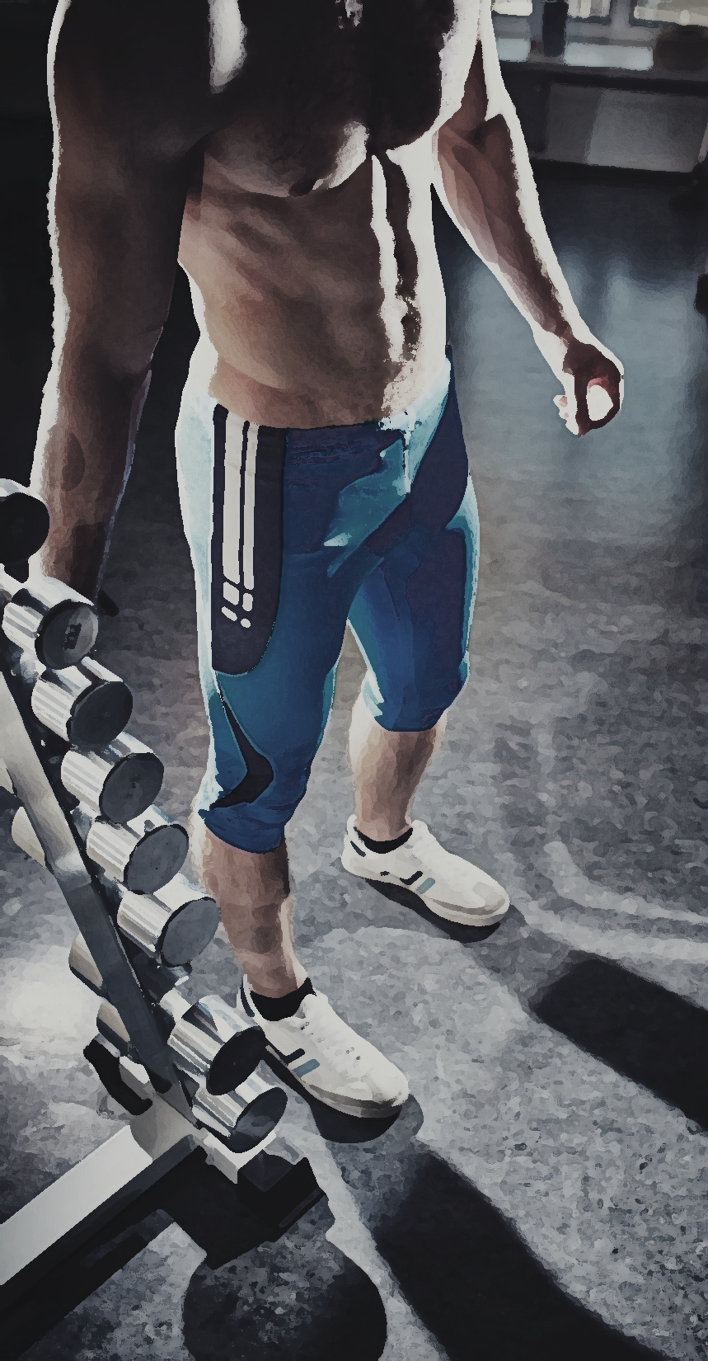
FIT ME
Fitness Intelligent Training
Mobile EMG
行動健身智能教練

